Slide 1

Flow: Static Type Checker for JavaScript Andranik Barseghyan https://github.com/Andranik93/Presentation

Slide 2
Static Type Checker ( Flow )
Overview
Static type checker
- Flow && TypeScript
- What is Flow?
How dose it work?
Basic Setup
What dose it look like? Code Example.
- Conclusion
- Resources

Slide 3



Static Type Checker

Slide 4



TypeScript
TypeScript is a typed superset of JavaScript that compiles to plain JavaScript.
https://www.typescriptlang.org

Slide 5



Flow
https://flow.org/

Slide 6
Flow vs TypeScript
-Checker | -Compiler
-Non-nullable by default | -Nullable by default
-Focused on Soundness | -Focused on Tooling & Scalability
-Written in OCaml: OSX Linux | -Written in TypeScript: any OS
-Works without any annotations | -Great IDE/Editor
-Works out of the box with React | -Used as default by more and more libraries

Slide 7
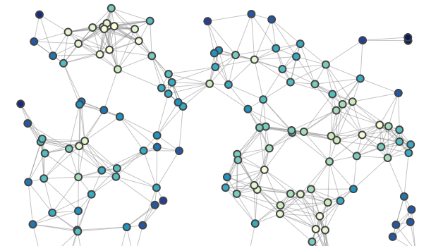
How dose it work?
Parse Code and generate AST
Inference phase . Traverse AST and gather information . Create Flow Graph
Evaluation . Traverse Flow Graph and find errors
For multiple modules . First, create Flow Graph for each module in parallel . Then connect Flow Graphs at their touch points Flow Graph Not the typical eager approach for type checking . Type is decided as late as possible Possibilities beyond type-checking . Tracking data through the application . Dead code elimination (inverse approach of tree-shaking)

Slide 8
Features
Maybe Types | Union and Intersection Types
Array and Tuples | Type Aliases
Classes | TypeoOf type
Object | Dinamic Type Tests
Function | Disjoint Unions
Destructuring | Modules
Declaration

Slide 9
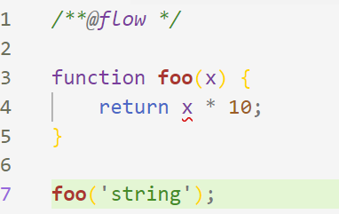
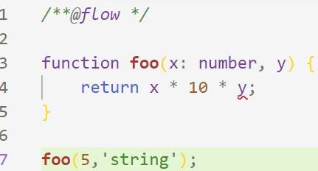
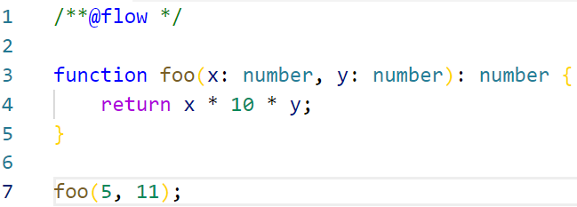
Example

Slide 10
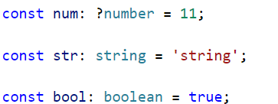
Primitive Types
Number (Infinity, NaN)
String
Boolean
null
undefined (void in Flow types)
Symbols (not yet supported in Flow)

Slide 11
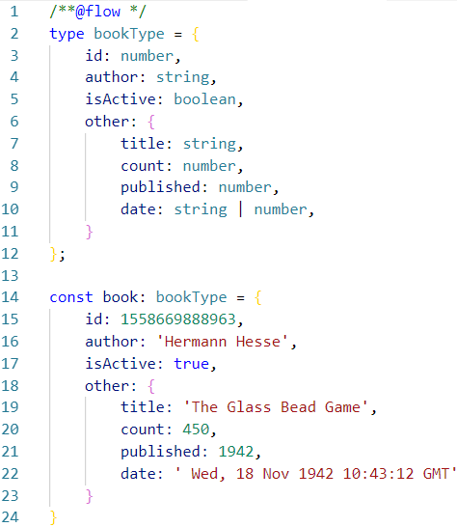
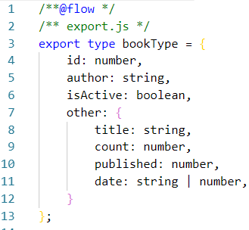

Type

Slide 12


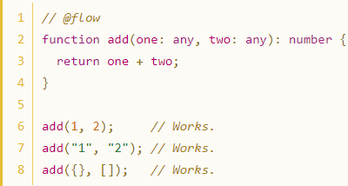
Mixed & Any Types
The difference is the ‘vice-verca’: any can flow into other types but mixed can not.
Any supports covariance and contravariance. It’s a super-type and a subtype of all types.
Mixed supports covariance only. It’s a super-type and not a sub type of all types.

Slide 13
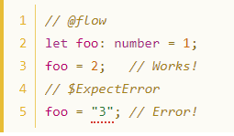


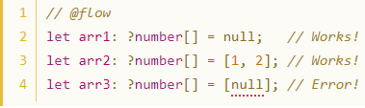
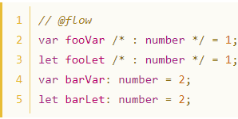

Variables, Array & Tuple Types

Slide 14
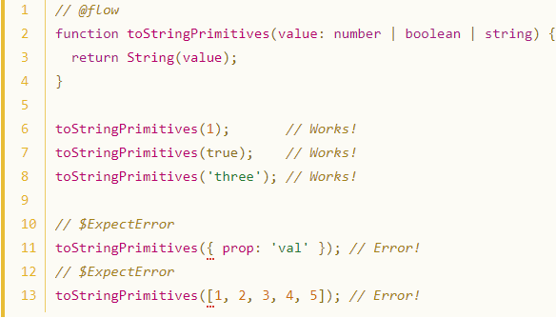
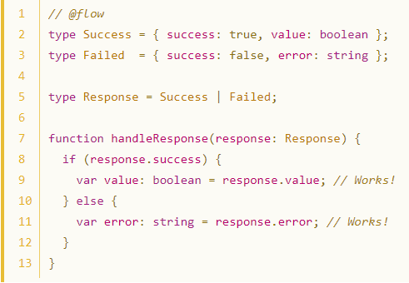
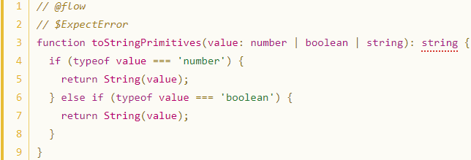
Union Types

Slide 15
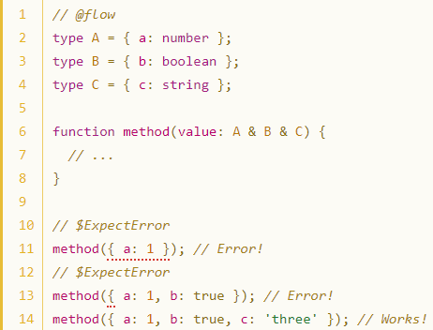
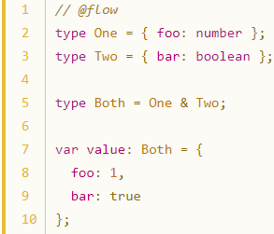
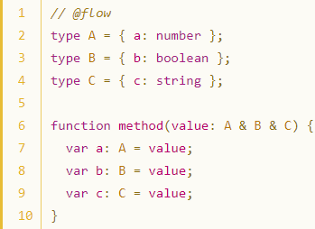
Intersection Types

Slide 16
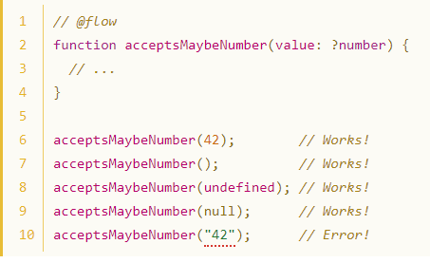
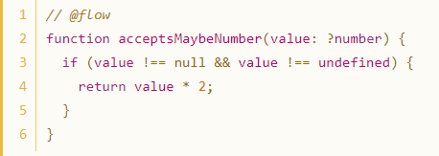
Maybe Types

Slide 17
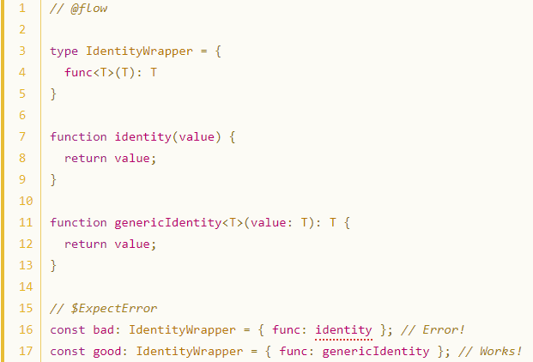
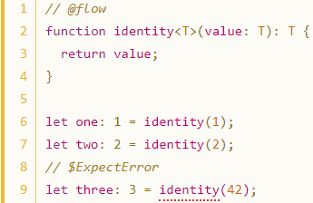
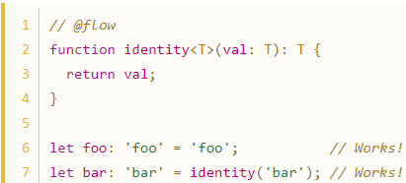
Generic Types

Slide 18
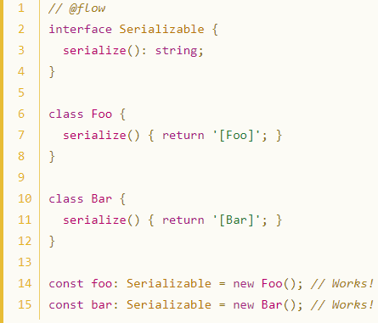

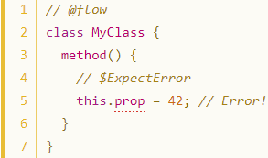
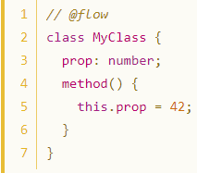
Class (Interface)

Slide 19
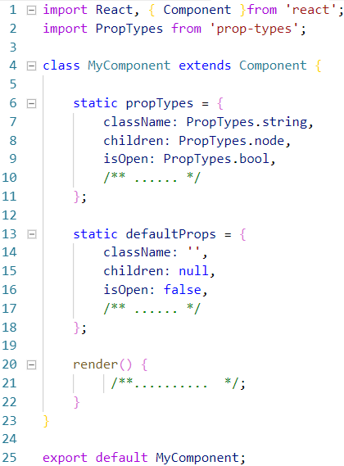
Prop Types

Slide 20
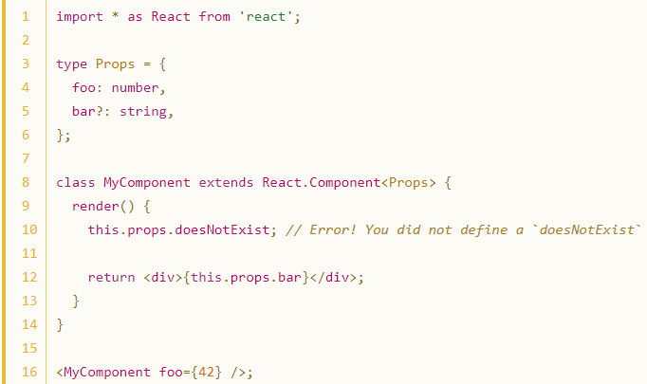
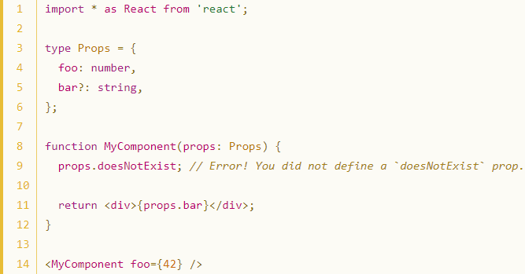
Class & Functional Component

Slide 21



Objective Caml Facebook.

Slide 22
Conclusion
Bub & Error
Documentation
Refactoring
Unit Testing

Slide 23


